Slide 1


SQL Murder Mystery: Solving a Crime Using Data Analysis
A data-driven investigation using SQL to uncover the truth behind a corporate murder
- Pratik Mendon

Slide 2

The Crime Scene
What Happened?
The CEO of TechNova Inc. has been found dead in their office on
October 15, 2025, at 9:00 PM.
Our Mission
You are the lead Data Analyst to analyze corporate databases to
identify the killer

Slide 3





The Digital Evidence Trail
Keycard Logs
Alibis
Phone Records
Every door access timestamped
Where suspects claim they were
Calls made during critical window
Crime Scene Evidence
Employee Database
Physical traces left behind
Profiles - Roles and Department

Slide 4
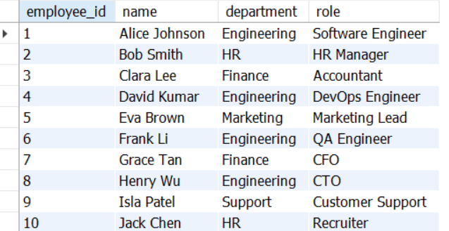
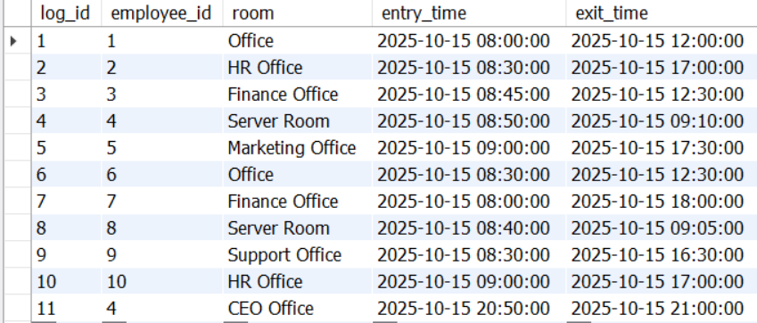
Employee Database
Profiles - Roles and Department
Keycard Logs
Every door access timestamped

Slide 5
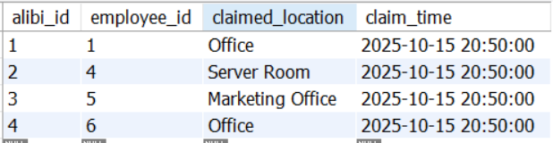
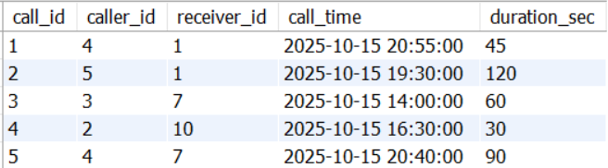
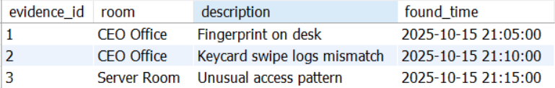
Alibis
Where suspects claim they were
Phone Records
Calls made during critical window
Crime Scene Evidence
Physical traces left behind

Slide 6
The Investigation Framework
01
02
03
Identify Access
Verify Alibis
Analyze Communications
Who entered the CEO's office near 21:00?
Cross-check claimed locations with logs
Examine calls between 20:50–21:00
04
05
Match Evidence
Converge Data
Connect physical traces to suspects
Identify the suspect who can't be cleared

Slide 7

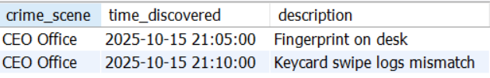
Query #1: Where and When the Crime happened?
SELECT room AS crime_scene,
found_time AS time_discovered,
`description`
FROM evidence WHERE room = 'CEO Office’
ORDER BY found_time;

Slide 8
Query #2: Analyze who accessed critical areas at the time
SELECT e.employee_id, e.`name`, k.log_id, k.room, k.entry_time, k.exit_time
FROM employees e JOIN keycard_logs k ON e.employee_id = k.employee_id
WHERE room = "CEO Office" AND entry_time BETWEEN "2025-10-15 20:30:00" AND "2025-10-15 21:10:00";
Why It Matters
Who entered the CEO’s Office close to the time of the murder?

Slide 9
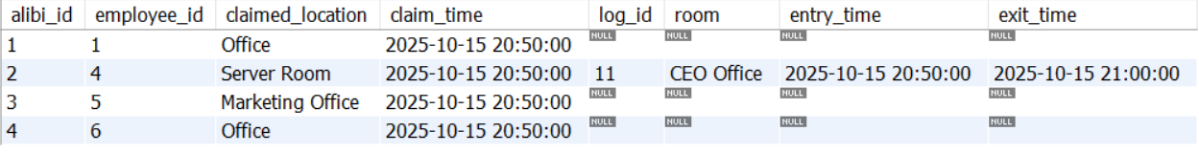
Query #3: Cross check Alibis with Actual logs
SELECT a.*, k.log_id, k.room, k.entry_time, k.exit_time
FROM alibis a LEFT JOIN keycard_logs k ON a.employee_id = k.employee_id
AND a.claim_time BETWEEN k.entry_time and k.exit_time ORDER BY alibi_id;
Why It Matters
Who claimed to be somewhere else but was not?

Slide 10

Query #4: Investigate Suspicious Phone Activity between 20:50 and 21:00
SELECT c.caller_id, e1.`name` AS caller_name, c.receiver_id,
e2.`name` AS receiver_name, c.call_time, c.duration_sec
FROM employees e1 LEFT JOIN calls c ON e1.employee_id = c.caller_id
LEFT JOIN employees e2 on e2.employee_id = c.receiver_id
WHERE c.call_time BETWEEN "2025-10-15 20:50:00" AND "2025-10-15 21:00:00";
Pattern Analysis
Multiple brief calls during murder window
Coordination or panic?

Slide 11
Query #5: Crime Scene Evidence Match with Movements and claims
20:50 – Entry time
1
Suspect enters CEO Office
2
21:00 – Time of Death
CEO found deceased
21:05 – Physical Evidence
3
Fingerprint on Desk
4
21:10 – Logs evidence
Keycard swipe logs mismatch
SELECT e.*, k.employee_id, es.`name`, k.log_id, k.entry_time, k.exit_time, a.claim_time, a.claimed_location FROM evidence e
LEFT JOIN keycard_logs k ON e.room = k.room LEFT JOIN employees es ON k.employee_id = es.employee_id LEFT JOIN alibis a
ON k.employee_id = a.employee_id WHERE e.found_time BETWEEN k.entry_time and date_add(k.exit_time, interval 15 minute);

Slide 12
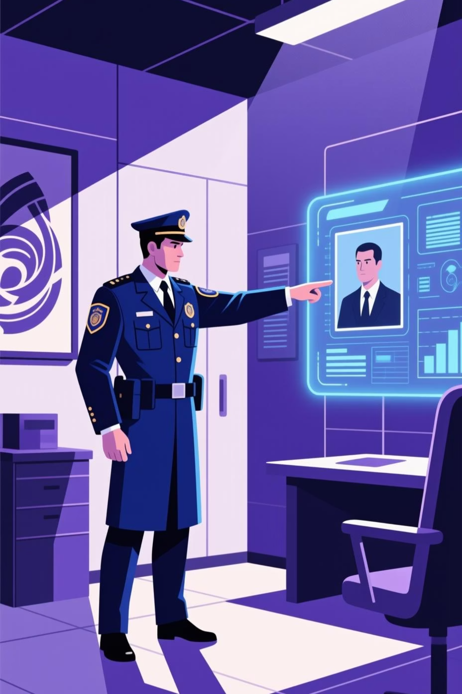
The Final Query: Convergence of Evidence
-- Findings from keylogs
WITH cte_key AS (SELECT e.employee_id, e.`name`, "Keylogs" AS Match_Found_in FROM employees e LEFT JOIN keycard_logs k ON e.employee_id = k.employee_id WHERE k.room = "CEO Office"),
-- Findings from calls
cte_calls AS (SELECT e.employee_id, e.`name`, "Call logs" AS Match_Found_in FROM employees e LEFT JOIN calls c ON e.employee_id = c.caller_id WHERE c.call_time BETWEEN "2025-10-15 20:30:00" AND "2025-10-15 21:10:00"),
-- Findings from alibis
cte_alibis AS (SELECT e.employee_id, e.`name`, "Alibis" AS Match_Found_in FROM employees e LEFT JOIN alibis a ON e.employee_id = a.employee_id
LEFT JOIN keycard_logs k ON a.employee_id = k.employee_id WHERE a.claim_time BETWEEN "2025-10-15 20:30:00" AND "2025-10-15 21:10:00"AND k.room <> a.claimed_location),
-- Findings from evidence
cte_evidence AS (SELECT e.employee_id, e.`name`, "Evidence" AS Match_Found_in FROM employees e LEFT JOIN keycard_logs k ON e.employee_id = k.employee_id LEFT JOIN evidence ec ON k.room = ec.room WHERE ec.found_time BETWEEN k.entry_time and date_add(k.exit_time, interval 15 minute))
SELECT `name` AS killer FROM cte_key UNION SELECT `name` AS killer FROM cte_calls UNION SELECT `name` AS killer FROM cte_alibis UNION SELECT `name` AS killer FROM cte_evidence;

Slide 13
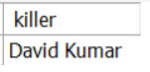

The Culprit
Case Closed
All evidence points to one individual: access logs place them at the scene, alibi contradicts keycard data, phone records show suspicious activity, and physical evidence confirms presence

Slide 14






Why This Project Matters
Complex Joins
Precise Filtering
Connecting 5 tables to build complete picture from fragmented data sources
Time-based queries, location matching, threshold conditions to isolate relevant records
Data Validation
Critical Thinking
Cross-referencing claims against reality, identifying inconsistencies and contradictions
Asking right questions, building logical investigation flow, connecting disparate clues
Timeline Reconstruction
Insight Generation
Ordering events chronologically to establish sequence and causation
Transforming raw database records into actionable intelligence and clear conclusions

Slide 15


Special Thanks

Slide 16


Let’s Connect
Pratik Mendon
Github - 21 Days SQL

